Slide 1
Ramping Up On The SharePoint Framework (SPFx)
Todd Baginski
Partner / CTO
Liberating Business Technologies

Slide 2


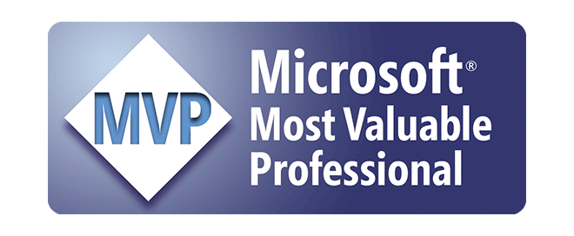
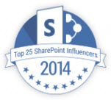
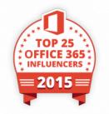


Who is this guy?
Todd Baginski
Partner & CTO
Husband, Dad, Coach, Sports Nut
Architect, Developer, Leader, Speaker
@toddbaginski
http://www.canviz.com
http://www.toddbaginski.com/blog
11-Time Microsoft MVP
2014-2016 Top 25 Community Influencer

Slide 3

What is the SharePoint Framework?
Why the SharePoint Framework?
Key Features
What training materials can I use to ramp up?
What is included in the training materials?
Walkthrough of training materials, demos, lessons learned

Slide 4
What is the SharePoint Framework
Page and web part model that provides full support for client-side SharePoint development, easy integration with SharePoint data, and support for open source tooling
You can use modern web technologies and tools in your preferred development
The SharePoint Framework works for SharePoint on-premises and SharePoint Online
https://dev.office.com/sharepoint/docs/spfx/sharepoint-framework-overview
Notes:
The SharePoint Framework (SPFx) is a page and web part model that provides full support for client-side SharePoint development, easy integration with SharePoint data, and support for open source tooling.
You can use modern web technologies and tools in your preferred development environment to build productive experiences and apps that are responsive and mobile-ready from day one.
The SharePoint Framework works for SharePoint on-premises and SharePoint Online.

Slide 5
Why the SharePoint Framework?
SharePoint was launched as an on-premises product in 2001.
Many features were written in C#, compiled to DLLs, and deployed to the servers.
That solution worked well in environments with only one enterprise, but it didn’t scale to the cloud.
MS introduced two alternative models: client-side JavaScript injection, and SharePoint Add-ins. Both of these solutions have pros and cons.
Current development models for the most part involve JavaScript running in a browser making REST API calls to the SharePoint and Office 365 back-end workloads, as well as other systems. C# assemblies don’t work in this world. Hence, the SharePoint Framework was born.
https://dev.office.com/sharepoint/docs/spfx/sharepoint-framework-overview
Notes:
SharePoint was launched as an on-premises product in 2001. Over time, a large developer community has extended and shaped it in many ways. For the most part, the developer community followed the same patterns and practices that the SharePoint product development team used, including web parts, SharePoint feature XML, and more. Many features were written in C#, compiled to DLLs, and deployed to the servers.
That solution worked well in environments with only one enterprise, but it didn’t scale to the cloud, where multiple tenants run side-by-side. As a result, MS introduced two alternative models: client-side JavaScript injection, and SharePoint Add-ins. Both of these solutions have pros and cons.
However, current development models for the most part involve JavaScript running in a browser making REST API calls to the SharePoint and Office 365 back-end workloads. C# assemblies don’t work in this world. We needed a new development model. The SharePoint Framework is the next evolution in SharePoint development

Slide 6
Key Features
Runs in the context of the current user and connection in the browser. There are no IFRAMES.
Controls are rendered in the normal page DOM.
Controls are responsive and accessible by nature.
Enables the developer to access the web part lifecycle.
Framework agnostic.
Toolchain based on common open source client development tools.
Performance is reliable.
End users can use SPFx client-side solutions on all sites, including self-service team, group, or personal sites.
Deployable in classic web part pages, publishing pages, & modern pages.
Notes:
Runs in the context of the current user and connection in the browser. There are no iFrames.
The controls are rendered in the normal page DOM.
The controls are responsive and accessible by nature.
Enables the developer to access the lifecycle - including, in addition to render - load, serialize and deserialize, configuration changes, and more.
It's framework agnostic. You can use any browser framework that you like: React, Handlebars, Knockout, Angular, and more.
The toolchain is based on common open source client development tools like npm, TypeScript, Yeoman, webpack, and gulp.
Performance is reliable.
End users can use SPFx client-side solutions that are approved by the tenant administrators (or their delegates) on all sites, including self-service team, group, or personal sites.
Solutions can be deployed in both classic web part and publishing pages and modern pages.

Slide 7
What training materials can I use to ramp up?
SPFx Training Modules
    https://github.com/OfficeDev/TrainingContent/tree/master/SharePoint/SharePointFramework
Patterns and Practices
    https://dev.office.com/patterns-and-practices
SharePoint StackExchange
    http://sharepoint.stackexchange.com/
Tag your questions and comments with #spfx, #spfx-webparts, and #spfx-tooling.
Documentation GitHub Repository
    https://github.com/SharePoint/sp-dev-docs

Slide 8
What is included in the training materials?
Currently 7 training modules available!
Slide decks
Hands On Labs
Source Code
  Starter Code
  Completed Demo Solutions
Videos (Coming Soon!)
https://github.com/OfficeDev/TrainingContent/tree/master/SharePoint/SharePointFramework

Slide 9
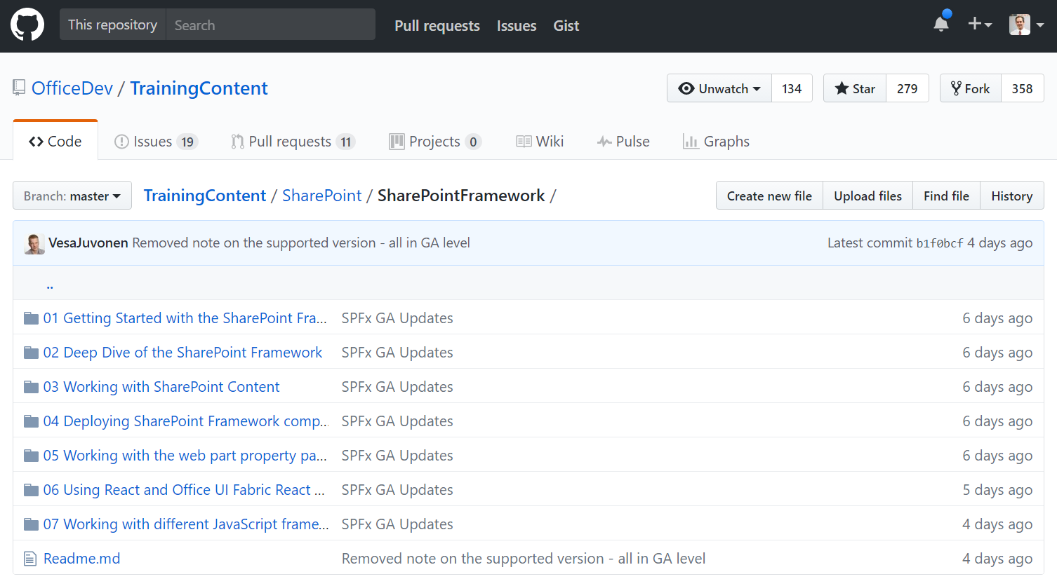
Walkthrough
Notes:
Content and structure overview.
Show a slide deck.
Demos:
Module 1
Ex 1 – Hello World (Local WB)
Do this exercise live. While generator runs, walk through VS code with Module 2 Deck 2.
Tip: Minimize how much code you check into source control.
Tip: Use Vs Code to open command prompt windows.
Tip: Use integrated terminal inside vs code.
Module 2
Ex 1 – SPFx Utilities, Lodash, Page Display Modes, Page Context, Environment Type, Logging API, (Local WB, O365 WB, Classic, Modern)
Tip: Page display modes should be part of your functional specification.
Tip: Your web part may not fit well on a modern page.
Module 3
Ex 1 – Mock Data (Local WB)
Tip: Mock data should closely match your production data.
Ex 2 – Read SP Data (O365 WB)
Ex 3 – CRUD (O365 WB)
Module 5
Ex 2 – Property Pane (Local WB)
Tip: Property pane functionality should be part of your functional specification.
Module 6
Ex 1 – Office UI Fabric Core (Local WB)
Tip: Have your designers get familiar with Office UI Fabric Core before starting design on a project.
Ex 2 – Office UI Fabric React Components (Local WB)
Tip: Have your designers get familiar with Office UI Fabric React Components before starting design on a project.
Tip: Don’t reinvent a control that already exists.
Tip: Test the controls in a POC before putting them into a final design.
Module 7
Ex 1 – Angular 1 CRUD (O365 WB)
Ex 2 – Knockout CRUD (O365 WB)
Ex 3 – jQuery, Chartist, Moment – Tasks List (O365 WB)
Tip: Keep in mind, you add payload to your web part each time you include another library. Only use the libraries you need.

Slide 10
Thanks!
@toddbaginski
http://www.canviz.com
http://www.toddbaginski.com/blog
Todd.Baginski@canviz.com

